Slide 1
Derivation algorithm
Roman Toda, Normex

Slide 2
History, Evolution of PDF
Graphical model, defined provisions for accurate on screen, when printed representation.
Adopted word rendering
Marked content
Introducing semantic into the content
Tagged PDF
First time used different presentation model for assistive technology

Slide 3
Problems today
How to use pdfs on mobiles
In browsers
In automated processes
We have to question the biggest strength, the very basic principle of PDF = precise layout
These days HTML rules the world when it comes to presenting content
Customers don’t care if we can interpret color precisely

Slide 4
Rendering vs Export
Why you don’t just convert pdf back to Word?
Rendering
Precise layout
Accurate representation
WYSIWYG
Export
Conversion
Using heuristics

Slide 5
Next generation PDF – what are the options?
BasePDF and alternates
Provide alternate representation for each device ?
Device ? or Media? Landscape/portrait?
Can we represent/interpret standard pdf differently than just rendering it?
Would it be possible to enrich pdfs and just use them in new environments?

Slide 6
Derivation
Derivation our new word for rendering
Is it possible to deterministically interpret PDF content in the web based environment?
Yes. We believe that TaggedPDF
provisions in ISO 32000-2 are rich enough to be unambiguously interpreted in html = Derived
are the best way to capture author’s intent

Slide 7
StructTree

Slide 8
StructTree

Slide 9
Standard structure element types
Chapter 14.8.4 in ISO 32000-2
Annot, Artifact, Aside, Caption, Document, DocumentFragment, Div, Em, FEnote, Figure, Form, Formula, H1..Hn, L, Lbl, LBody, LI, Link, P, RB, RP, RT, Ruby, Span, Strong, Sub, Table, TBody, TD, TFoot, TH THead, Title, TR, Warichu, WT, WP
Some sound like html tags: Div, Span, P, H1, LI
Some are harder to imagine: Annot
RoleMap may be involved

Slide 10
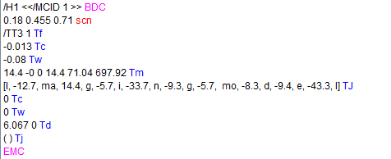
Text

Slide 11
Text

Slide 12
Text

Slide 13
Text

Slide 14
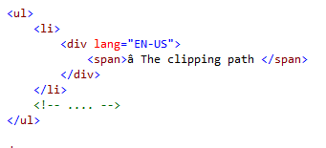
List

Slide 15
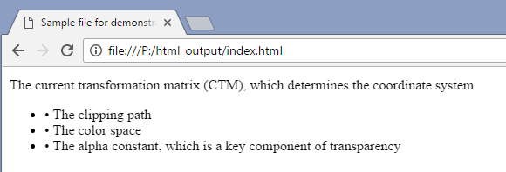
List

Slide 16
List – what author wants?

Slide 17
List – better tagging
Best Practice Guide

Slide 18
List – better tagging
Best Practice Guide

Slide 19
List – problems with tools today
Best Practice Guide

Slide 20
List – problems with tools today
Best Practice Guide

Slide 21
Table

Slide 22
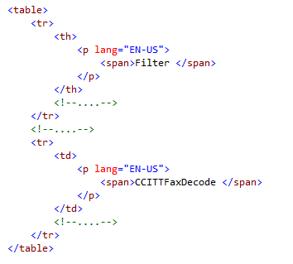
Table - derivation

Slide 23
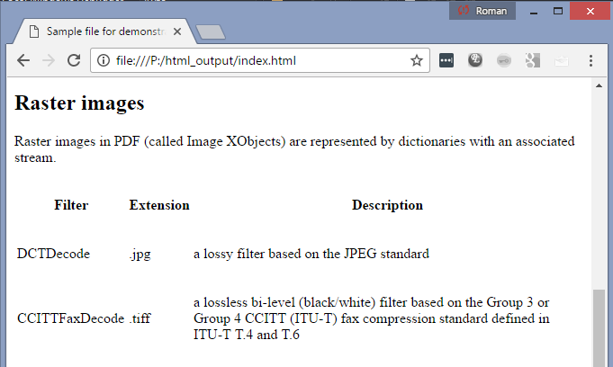
Table - derivation

Slide 24
Attributes – general concept
Each Tag can be better described by attributes
Different “owners”

Slide 25
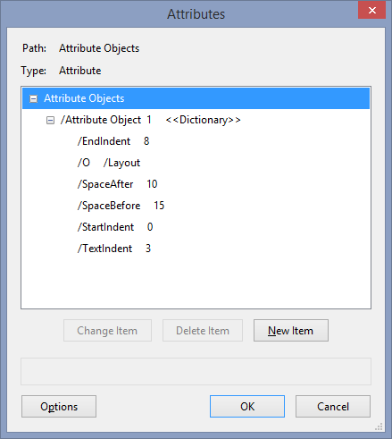
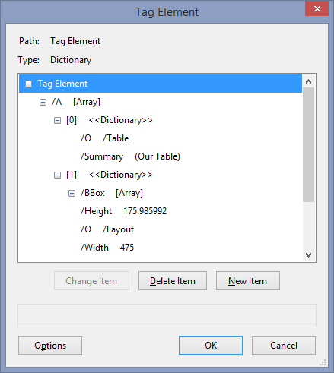
Attributes – general concept
Examples for Text and Table tags
Text element
Table element

Slide 26
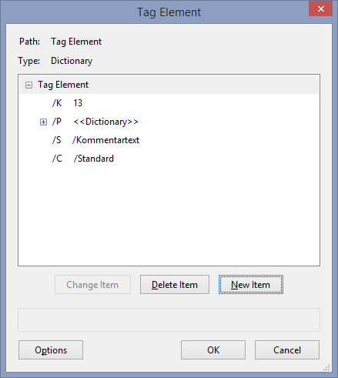
Attributes – general concept

Slide 27
Attributes – general concept

Slide 28
Attributes – general concept

Slide 29
Attribute owners
Derivation only looks at CSS
TaggedPDFs are not responsive pdfs

Slide 30
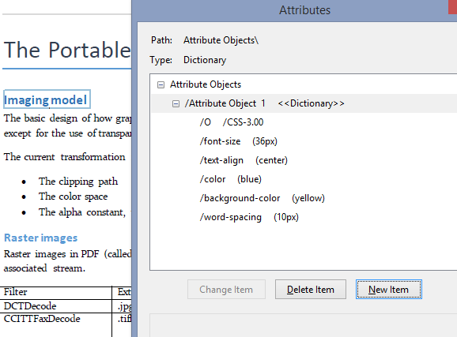
Attribute usage - styling
Can use the whole power of CSS

Slide 31
Attribute usage - styling

Slide 32
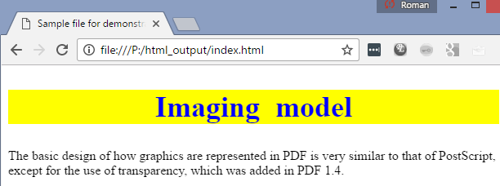
Attribute usage - styling

Slide 33
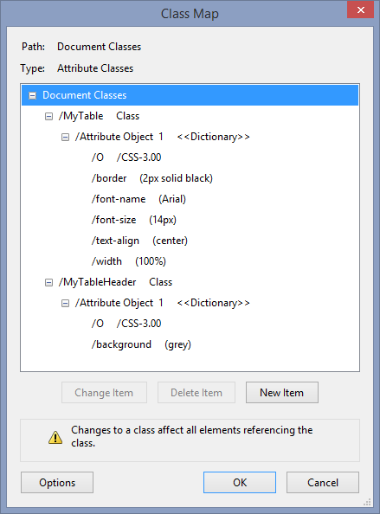
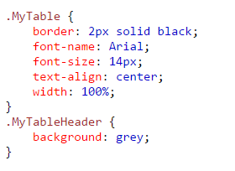
Table again - styling
Let’s define ClassMap for our table and header
.css

Slide 34
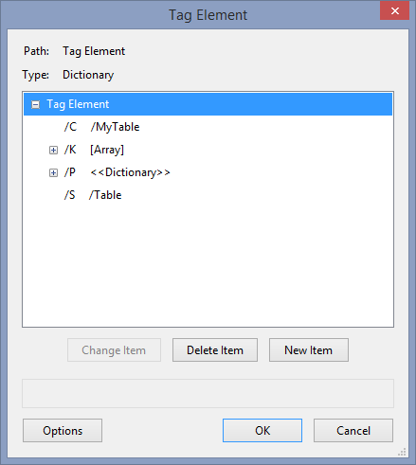
Styling - table

Slide 35
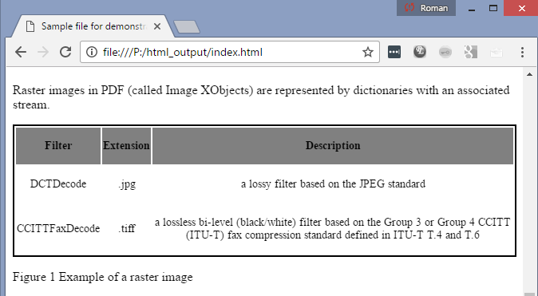
Styling - table

Slide 36
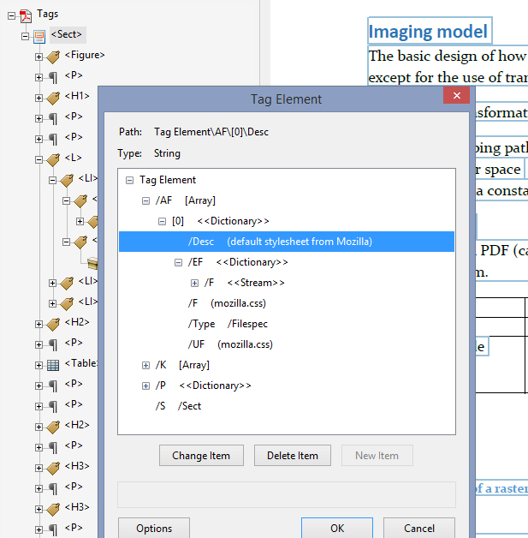
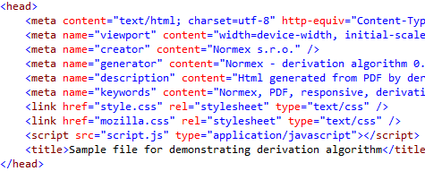
Own stylesheet? Use Associated files
Mozilla: https://hg.mozilla.org/mozilla-central/file/tip/layout/style/res/html.css

Slide 37
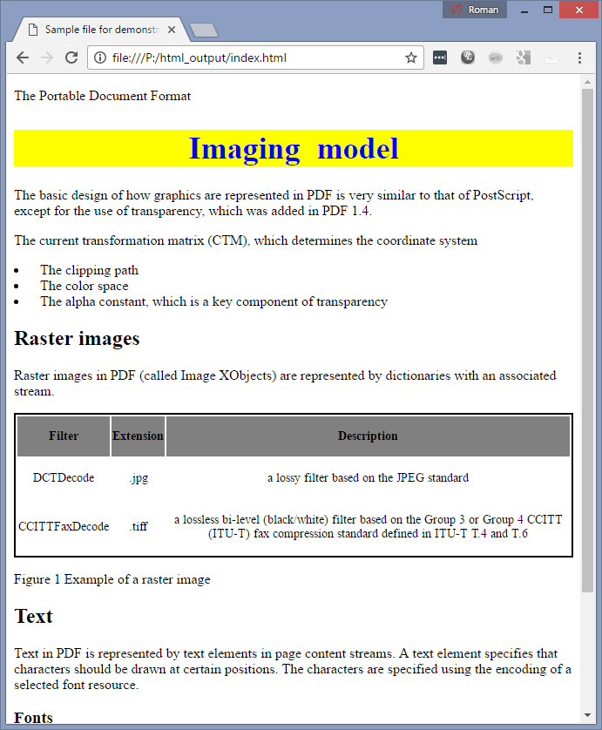
Own stylesheet? Use Associated files
webkit

Slide 38
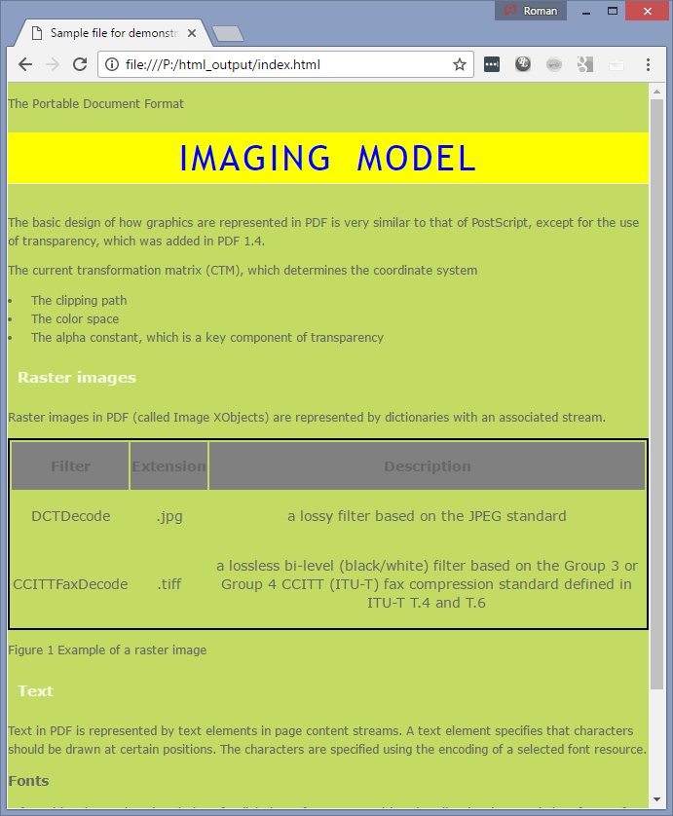
Own stylesheet? Use Associated files
green

Slide 39
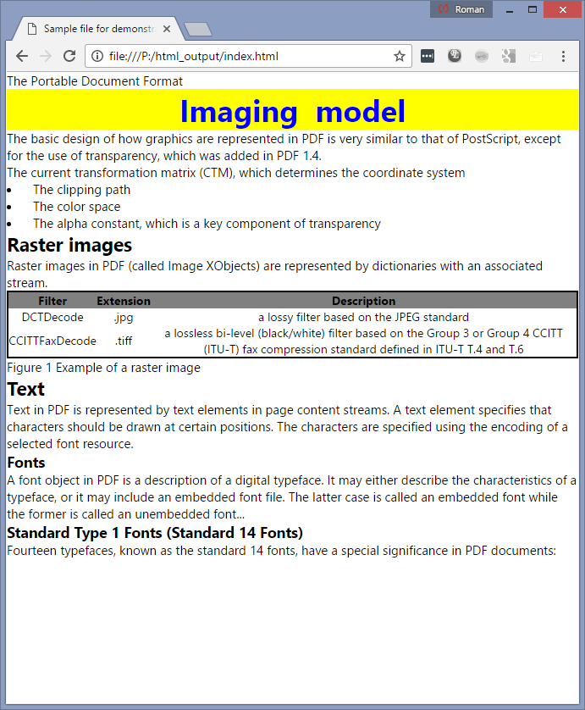
Own stylesheet? Use Associated files
MS

Slide 40
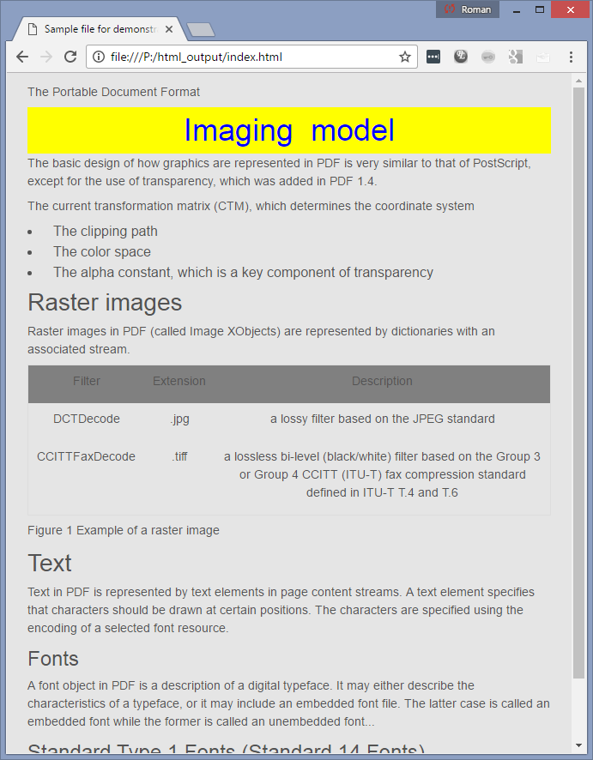
Own stylesheet? Use Associated files
Adobe

Slide 41
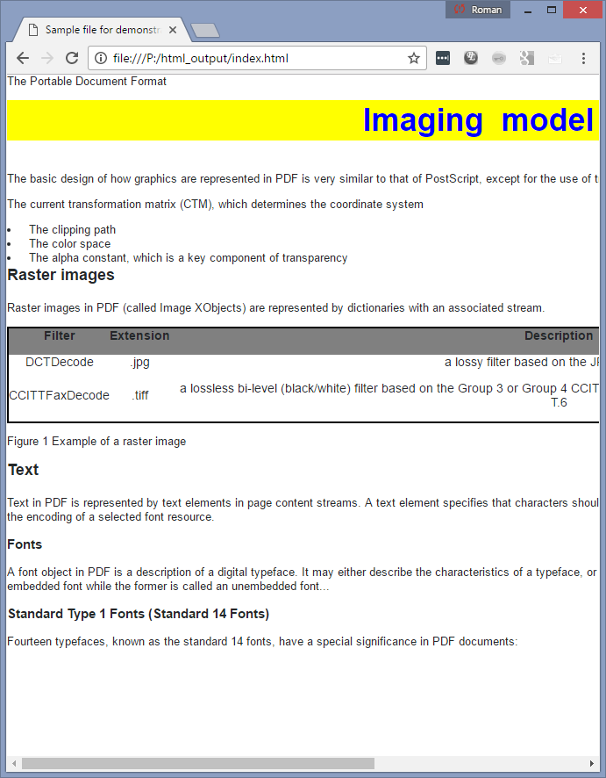
Own stylesheet? Use Associated files
stackowerflow

Slide 42
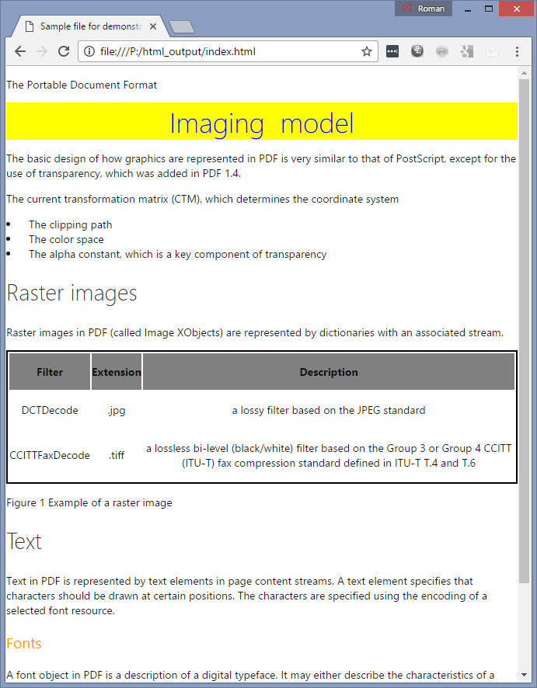
Own stylesheet? Use Associated files

Slide 43
What else is considered?
Easy? NO
Metadata
Destinations
Annotations
Aria roles
MathML
SVG
Forms/ data
….

Slide 44
Summary
World of single representation is over. Today we need to read out loud our pdfs, but what’s going to be tomorrow?
It’s time to stop producing bad pdfs
It’s time to give authors full control over pdf interpretation
Author decides instead of tool decides
Instead of saying there is only one way to interpret PDF we will be saying that there is always deterministic way of interpreting pdf

Slide 45
Thank you
Q&A

