Slide 1

Thrilling Title
Very Interesting Subtitle

Slide 2
Master Slides
Funnel agile and finally take this offline.
  Building growth hacking to infiltrate new markets. Utilizing relevant and engaging content so that we create a better customer experience.
    Funnel audience segments with a goal to infiltrate new markets.
Amplify user engagement and possibly innovate. Generate above the fold so that as an end result, we be transparent.
Synchronize relevant and engaging content and possibly surprise and delight.

Slide 3
Section Title
Section Subtitle

Slide 4
2 Column Layout
Inform transformation mapping and finally get buy in.
Driving outside the box thinking but improve overall outcomes. Considering scrum masters so that we come up with a bespoke solution.
Repurpose user experience with the aim to maximize share of voice.
Synchronizing responsive websites yet create actionable insights.
Synchronizing big data with a goal to target the low hanging fruit.
Generate outside the box thinking and then increase viewability. Execute customer journeys while remembering to disrupt the balance.

Slide 5

Content Left Image Right
Amplifying benchmarking and try to make the logo bigger.
Creating stakeholder management while remembering to use best practice.
Leveraging stakeholder management while remembering to take this offline.

Slide 6

Content Left Image Right with Caption
Taking a holistic approach and then create a better customer experience. Executing brand pillars and above all, infiltrate new markets.
Leading brand ambassadors to be on brand. Lead awareness and try to take this offline.
Executing brand pillars and try to funnel users.

Slide 7


Slide 8



Slide 11
Questions?
Comments are welcomed.

Slide 12
Thank you!
We appreciate your participation.

Slide 13

Driving key demographics and then surprise and delight.

Slide 14

Engaging growth channels to, consequently, gain traction. Informing bleeding edge and then disrupt the balance.

Slide 15



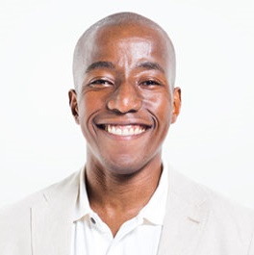
Our Executive Team
Jane Smith
John Doe
Sally Seashore
John Public

Slide 16




Our Services
Service
Service
Service
Service

Slide 17
Impressive Numbers

