Slide 1
Robotic Process Automation and PDF
Neil Pitman Director, Aquaforest Limited
Monday, April 27th 2020
***FIRST DRAFT***
Robo-PDF Apocalypse or Automated PDF Utopia?

Slide 2
Session Overview
Robotic Process Automation (RPA) uses software robots to mimic human actions and automate everyday tasks.
This session will explain the place that PDF plays in the range of solutions that may be classified as Robotic Process Automation and how RPA fits in the wider spectrum of automation.
Use cases will be discussed and particular mention will be given to PDF-centric issues that need to be considered for successful implementations.

Slide 3
Agenda
Introduction to RPA
RPA and the Automation Spectrum
PDF and RPA
Practical Examples
Technologies for PDF and RPA
Future Visions

Slide 4
Will we have Robo-PDF Apocalypse?

Slide 5
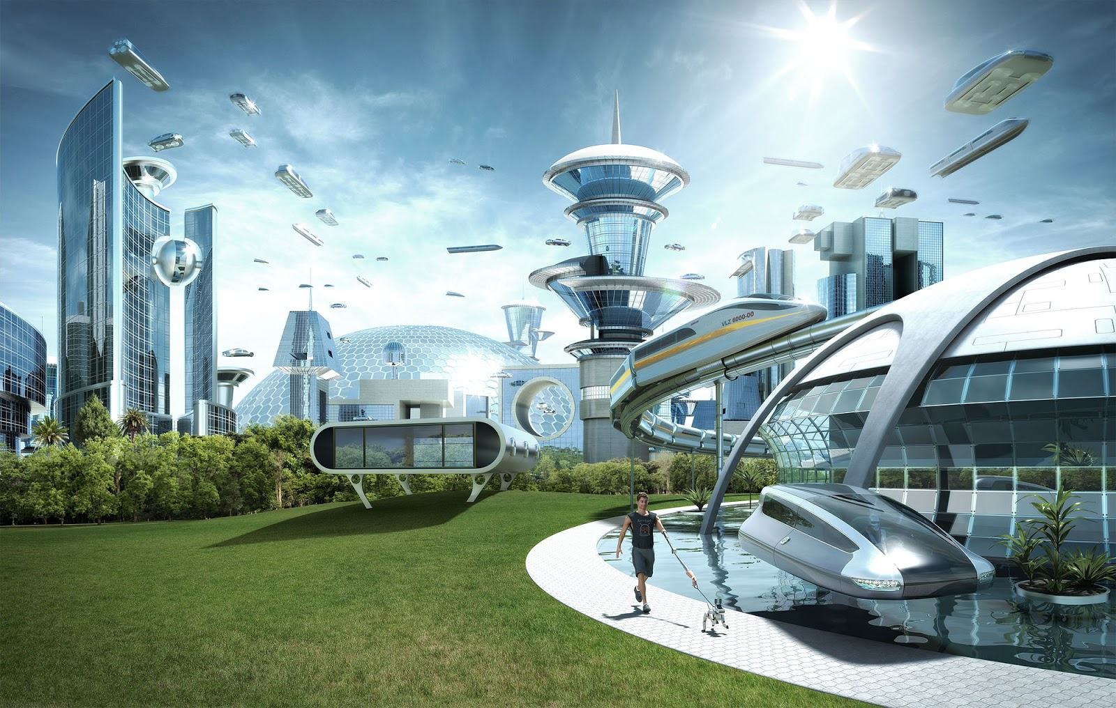
… or Automated PDF Utopia?

Slide 6
Interest in RPA

Slide 7
Introduction to RPA - Video

Slide 8
Benefits of RPA
Increased Accuracy
Low Barriers
Meet Regulatory Compliance Standards
24/7 - No Interruption of Work
The System Remains in place
Improvement in Modeling the Employee’s Exposure in the RPA
Increase in Productivity

Slide 9
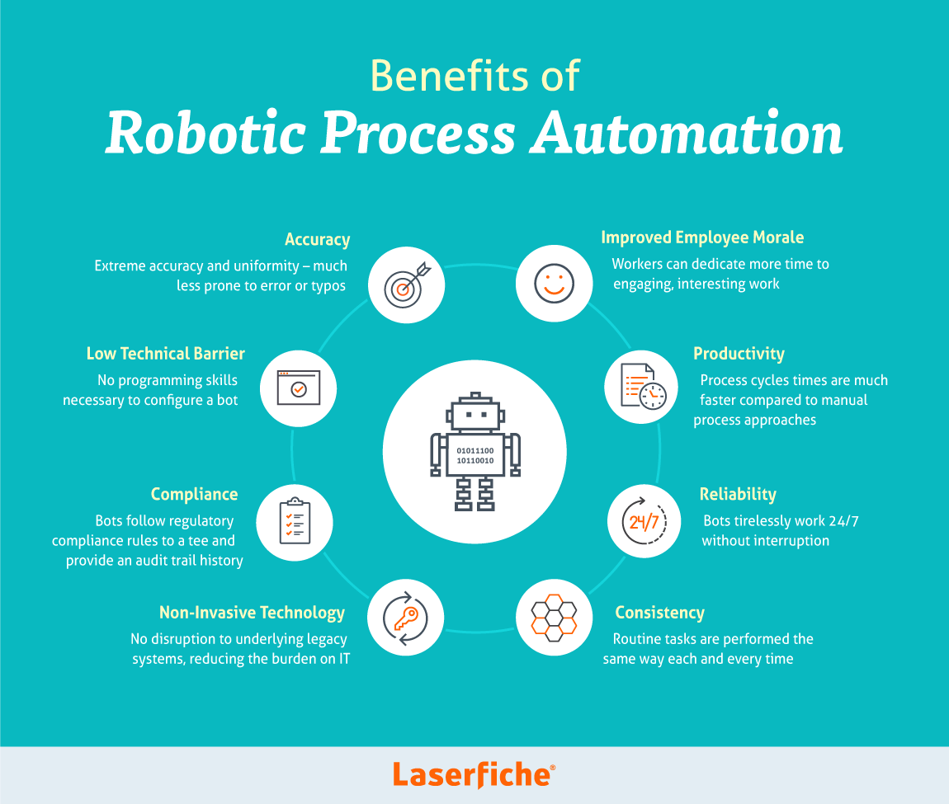
Benefits of RPA

Slide 10
Typical Processes
Business Process
Consistent and routine
High volume
Prone to human error
Limited in requiring a person to make a decision
Manual data entry or “swivel chair” work
Technology
Legacy Systems
No APIs

Slide 11
Common Use Cases
Payroll
Employee status changes
New hire recruitment and onboarding
Accounts receivable and accounts payable
Invoice processing
Inventory management
Report creation
Updating CRM data
Software installations
Data migration
Vendor onboarding

Slide 12
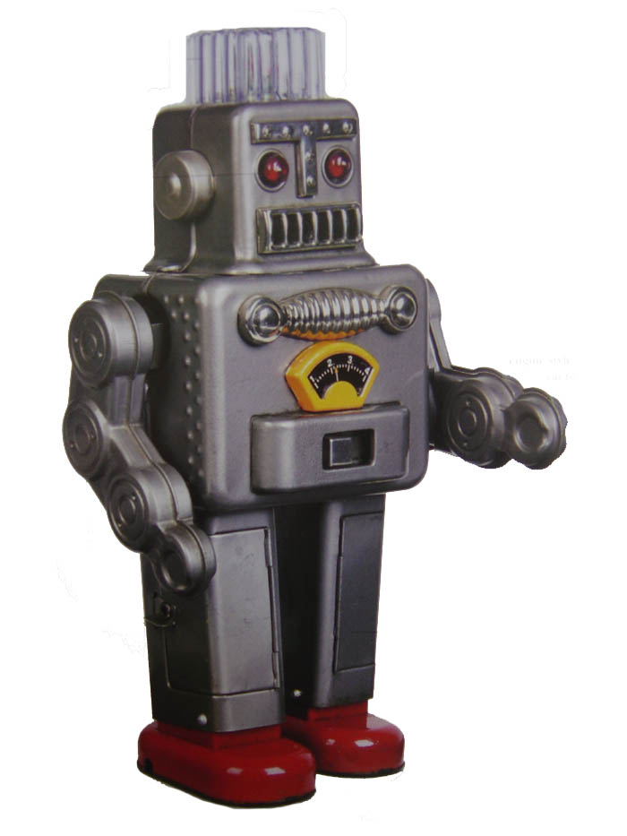
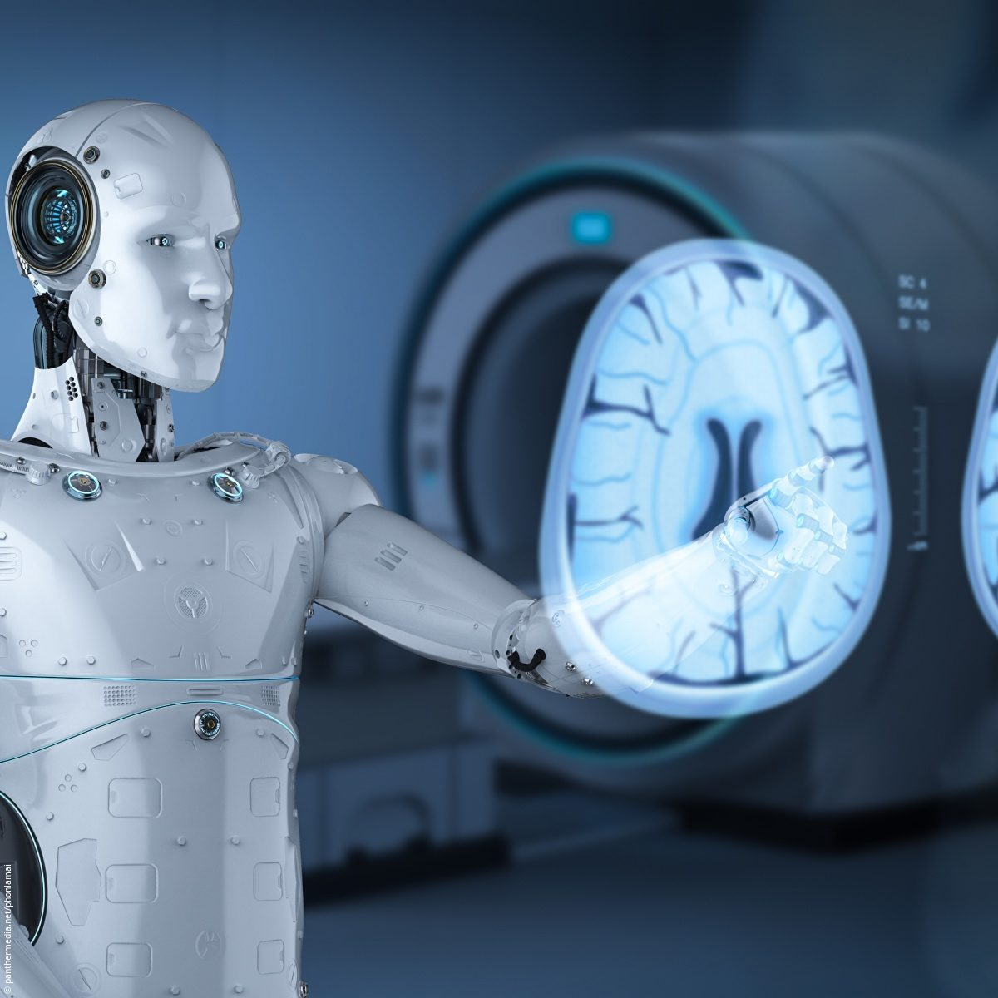
RPA and the Automation Spectrum

Slide 13
Robotic Process Automation
Mimics Human Actions
Used for rules based, simple to complex processes
Enables
Faster handing time
Higher volumes
Reduced errors & costs

Slide 14
Intelligent Automation
Mimics Human Judgement
Used for judgement based processes
Machine learning capability
Interprets human behavior

Slide 15
Cognitive Intelligence
Augments Human Intelligence
Used for Predictive ‘Decisioning’
Dynamically self-adaptable and managing

Slide 16
AI
Mimics Human Intellience
Acquires human-like thought processing and thinking capabilities

Slide 17
PDF and RPA

Slide 18
Practical Examples
Demonstrations

Slide 19
Example 1
Simple “assisted” case – Supplier Onboarding
Email – PDF – Reader – Legacy System or Salesforce

Slide 20
<Example 1 Video>
<Video Here>

Slide 21
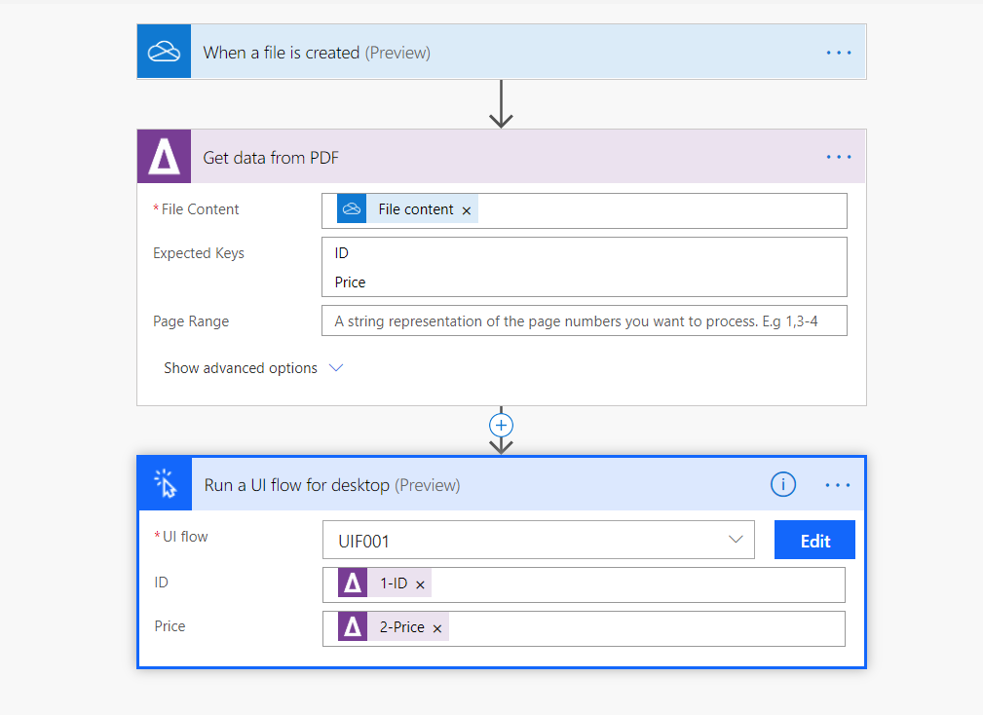
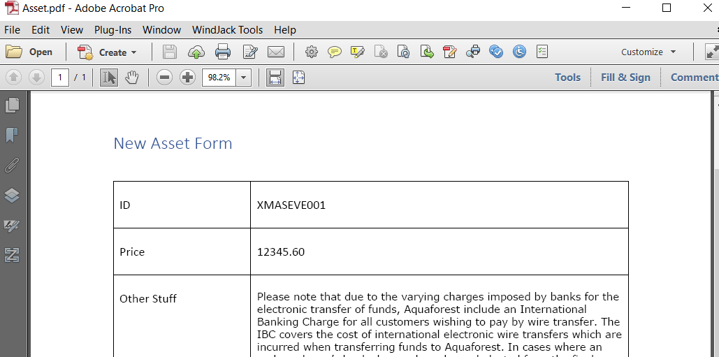
<Example 1 Screenshots>

Slide 22
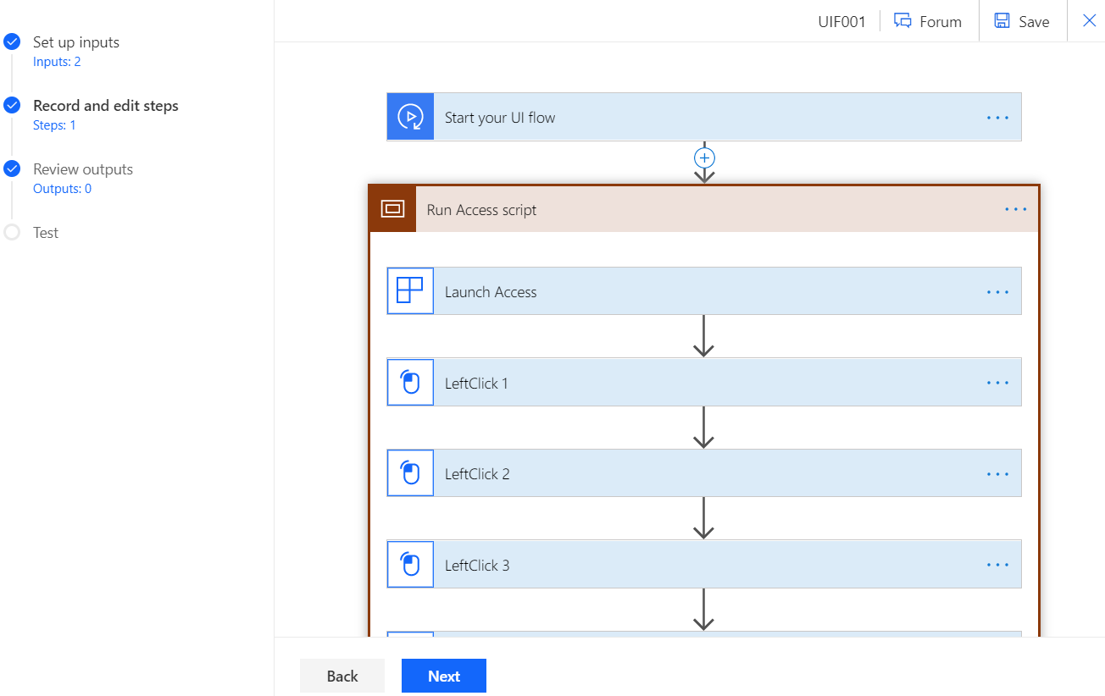
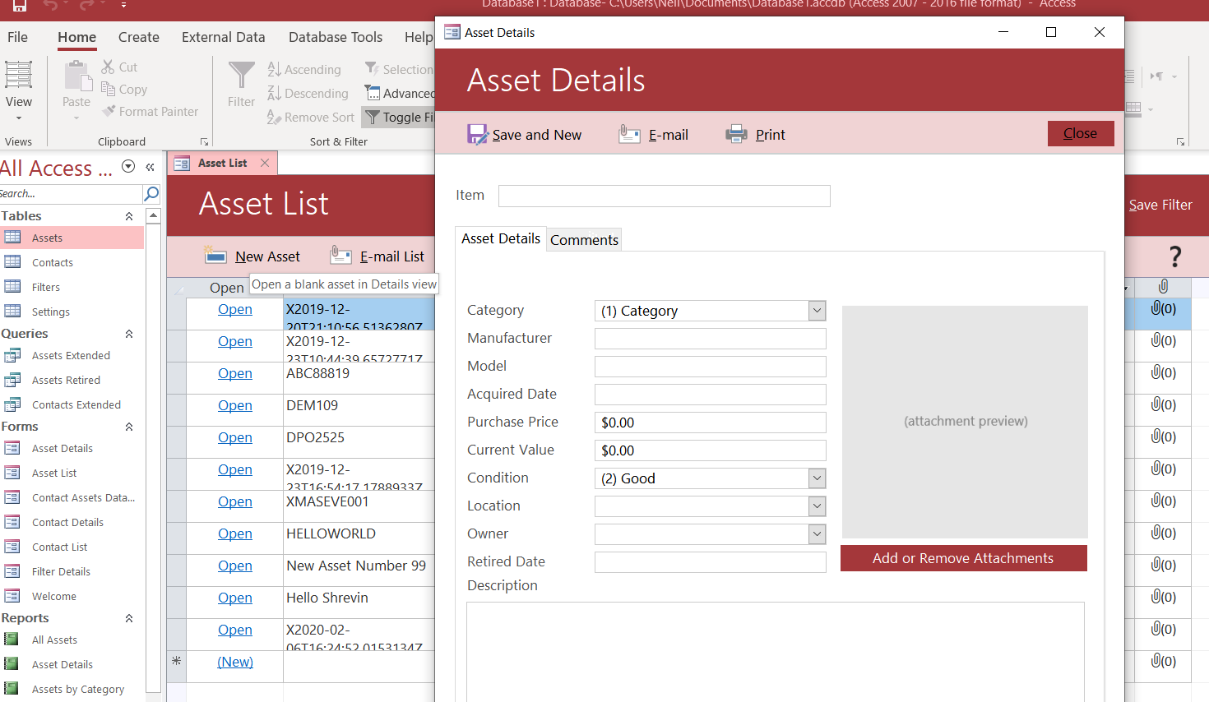
<Example 1 Screenshots>

Slide 23
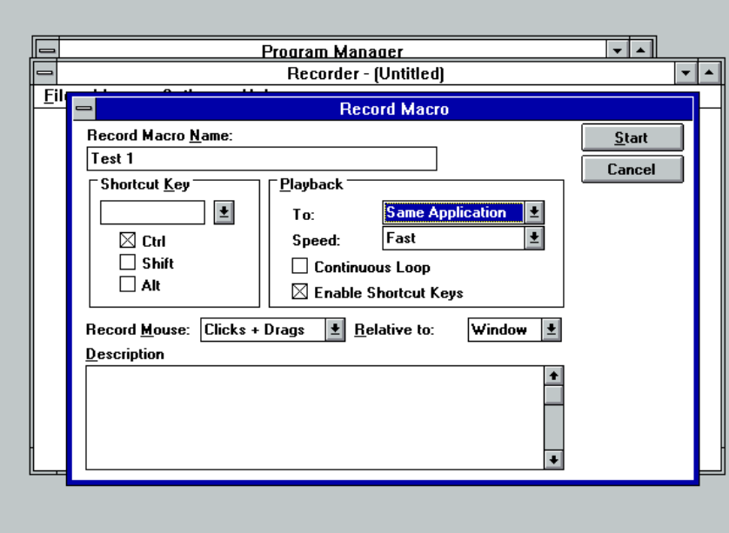
Windows 3.1 Macro Recorder!

Slide 24
Example 2
Simple “unassisted” case
Email or Web Page -PDF – Analyse – Add/Update Excel

Slide 25
<Example 2 Video>
<Video Here>

Slide 26
<Example 2 Screenshots>

Slide 27
PDF and RPA
The Challenge :
Extract, Process and Recognize Structured and Semi-Structured data from PDF as part of the RPA pipeline

Slide 28
Approaches
Structured PDF Data
XMP
Tagged PDF
ZUGFeRD
Recognition Technologies
Machine Learning
Template-Based
Model-Based

Slide 29
Technologies for PDF and RPA

Slide 30
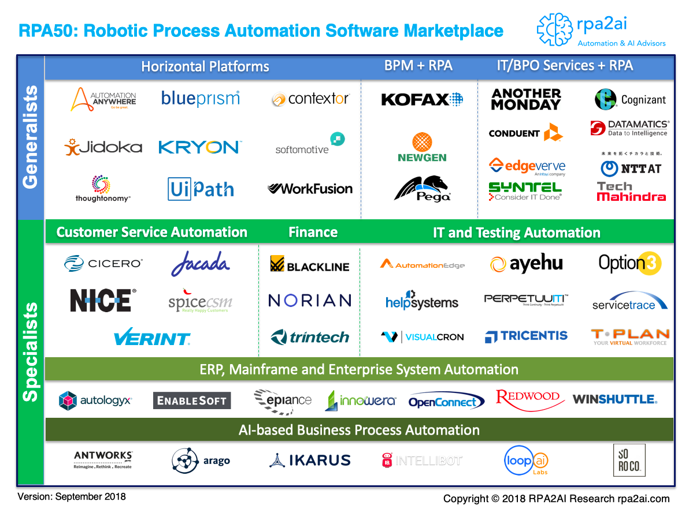
RPA Marketplace

Slide 31
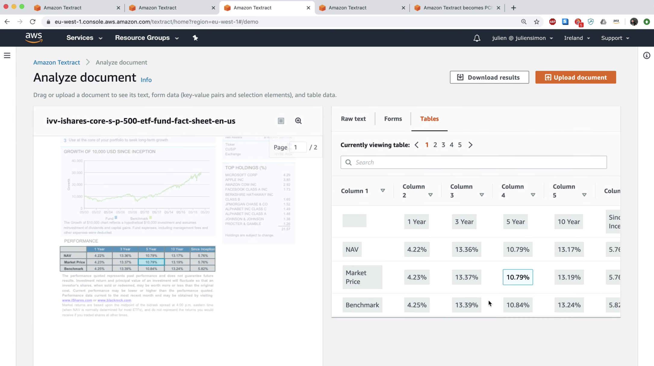
Amazon Textract

Slide 32
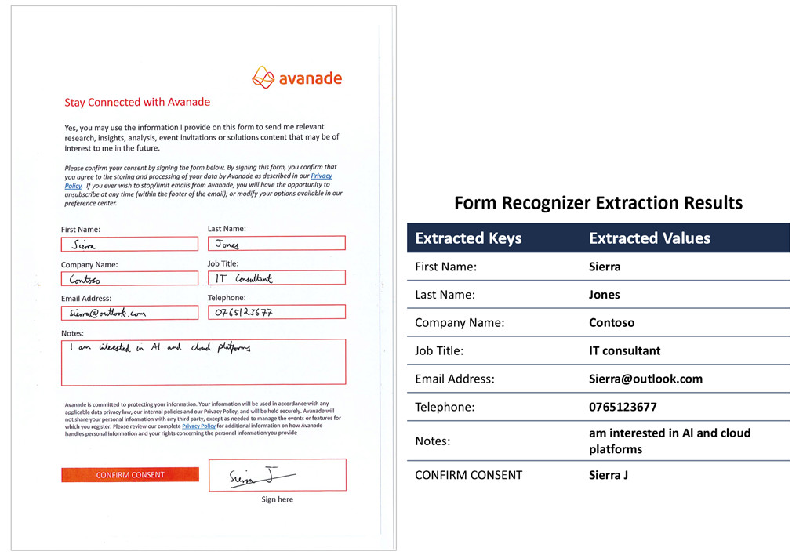
Microsoft Forms Recognizer

Slide 33
Aquaforest PDF Connector

Slide 34
Future Visions
PDF is a natural part of the RPA pipeline
True Machine Readable PDF
..
..

Slide 35
Robotic Process Automation and PDF
Neil Pitman Director, Aquaforest Limited
Monday, April 27th 2020
***FIRST DRAFT***
Robo-PDF Apocalypse or Automated PDF Utopia?

