Slide 1
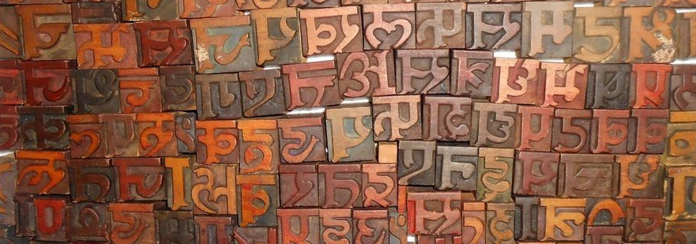
Support of complex scripts in PDF
Lego game of text composition and text extraction algorithms
Alexey Subach, iText Software
Notes:
https://www.deviantart.com/lalitkala/art/typewriter-godrej-Nepali-devanagari-letterpress-289374423
https://i.pinimg.com/originals/f9/cc/cb/f9cccb5114c36245c8590705e13bbffb.jpg
https://www.pinterest.com/pin/432627107932817327/

Slide 2
Talk Outline

Slide 3
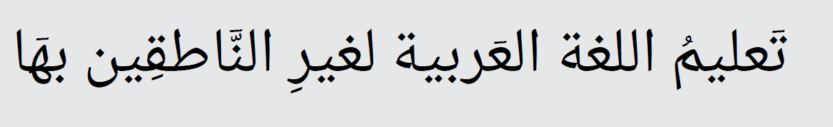
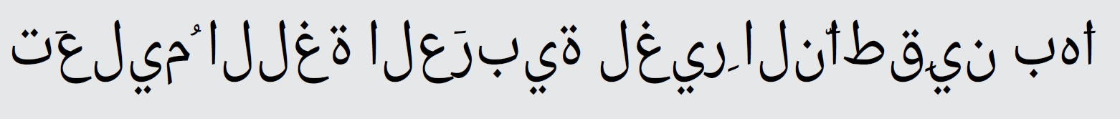
Complex scripts are complex!
To get this:
Instead of that:
…you have got a long way to go
Notes:
With calligraph and without calligraph
(text says Teaching the Arabic language to non-native speakers)

Slide 4
Steps in processing complex scripts
Cluster characters into syllables or words
Apply Unicode character reordering
Apply Open Type features (shaping)
Apply layout-related processing, e.g. hyphenation
Apply Unicode Bidi algorithm
Write content using correct syntax (to view and extract data)
Create tag structure
Extract content back from PDF to Unicode
Notes:
Please note that this is not a silver bullet and depending on the script and context some of these steps may be omitted or slightly changed. But the main takeaway is that each of these complex steps is vital for your software to work in general case

Slide 5
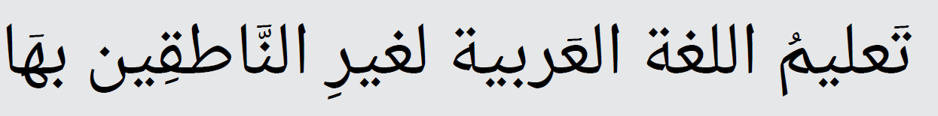
Example: Arabic text
Notes:
Here we overview an example of which transformations a piece of Arabic text undergoes during the process of adding such text into PDF
Step1: Initial text (logical sequence)
Step2: LTR
Step3: Shaping (init, medi, fina)
Step4: Vowel positioning (consonants and long vowels are represented by letters but short vowels and consonant length are not generally indicated in writing; only religious texts, children's books and works for learners are written with the full tashkīl - vowel guides and consonant length)

Slide 6
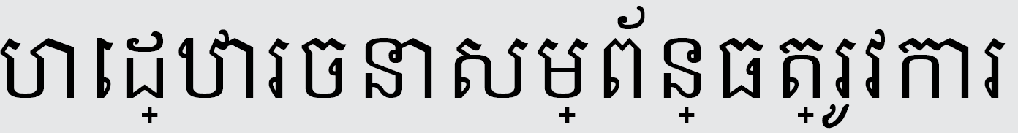
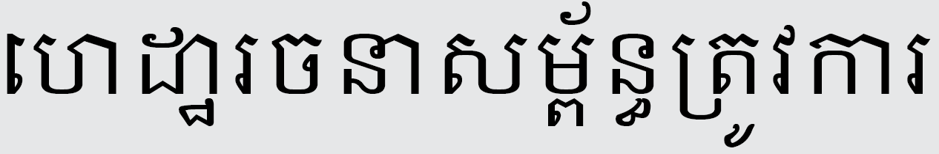
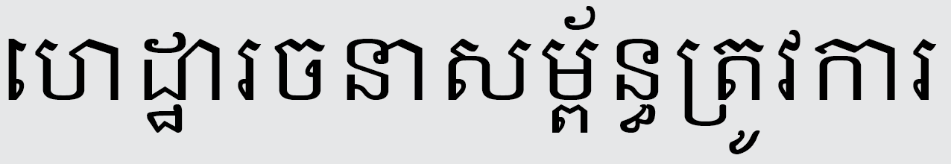
Example: Indic text
Notes:
Step1: Initial text
Step2: Reordering
Step3: GPOS
Step4: GSUB
No right to left, what can be easier? Turns out it’s a question what is easier in the end.
What is true for Arabic language is also very much the same for the group of Indic languages. In total probably just under 2 billion people are potentially affected by these complex script requirements

Slide 7
Bidi algorithm
Logical vs visual representation
Unicode Bidirectional Algorithm
Notes:
The first and foremost thing in displaying RTL texts is BIDI algorithm.
Let’s have a better understanding on why Bidi algorithm is needed at all?
Why not just display the portion of the text that fit into the screen? Right to left should not be as difficult, right?

Slide 8
Bidi algorithm
Mixed directions in text: numbers are still shown left-to-right
Character mirroring
/ReversedChars
Notes:
The first and foremost thing in displaying RTL texts is BIDI algorithm.
Let’s have a better understanding on why Bidi algorithm is needed at all?
Why not just display the portion of the text that fit into the screen? Right to left should not be as difficult, right?

Slide 9
Arabic shaping: 4 glyph forms

Slide 10
Font Implementation
Open Type fonts contain tables with the relevant information
Fonts also must be of good quality as they provide vital information for shaping

Slide 11
What if fonts are lacking some info?
Some operations can be done purely on Unicode level, e.g. Arabic shaping
Extensive Unicode information is a requirement in that case
Default, Init, Medi, Fina, forms of glyphs require 4x characters in Unicode
Impractical to store all the combinations at the Unicode level
TODO example Arabic glyphs
Notes:
TODO: Is “default” option really an option?
Although that might have taken off some burden from font creators if all the transformations were applied at the Unicode level and all the rules were described there, Unicode would be overcrowded by all those combinations

Slide 12
PDF Implementation
Syllable (cluster) is a minimal unit that can guarantee correspondence between visual representation and Unicode sequence that you get on copy-paste
Notes:
Creating good quality PDFs is much harder than just using standard text showing operators passing the corresponding glyphs as arguments

Slide 13
Attaching glyph to one another

Slide 14
Mark to ligature attachment

Slide 15
Text extraction: getting trickier
We can cheat and add “fake mappings” from a glyph to Unicode characters and they will work unless you have those glyphs in other context in the text
Notes:
Syllable (cluster) is a minimal unit that can guarantee correspondence between visual representation and Unicode sequence that you get on copy-paste

Slide 16
/ActualText is our savior!
Can be specified for content that does translate into text but that is represented in a nonstandard way (ISO 32000-2)
Replacement text can be specified for the following items:
A structure element, by means of the optional ActualText entry (PDF 1.4) of the structure element dictionary.
(PDF 1.5) A marked-content sequence, through an ActualText entry in a property list attached to the marked-content sequence with a Span tag.
Notes:
Turns out in many cases it has to be specified!

Slide 17
/ActualText
Not supported in many PDF viewers
Problems with determining spaces when extracting text (TODO double check!!)
If each of two (or more) consecutive structure or marked-content sequences has an ActualText entry, they shall be treated as if no word break is present between them

Slide 18
Wrapping at word boundaries
Thai, Khmer

Slide 19
RTL text: correct tagging
Follow the logical order and not the visual one
How to restore the info from tag structure? (sort?)

Slide 20
RTL text: missing /ReversedChars
Inverse bidi algorithm

Slide 21
Extracting base glyphs + marks
Need to be careful with sorting

Slide 22
Conclusions
PDF Producer
Unicode-level rule-based transformations and OpenType font features + Bidi algorithm to create correct glyph sequence
Applying text showing operators and /ActualText carefully to create extractable (and still visually correct) text
PDF Viewer
Watch for glyph clusters glued together by /ActualText definition
Sort the glyphs taking marks and base glyphs into consideration
Notes:
From the technical standpoint, additional work for supporting complex scripts is required both at the PDF Producer level and PDF Consumer/Processor level, compared to the basic implementation

Slide 23
Conclusions
All the pieces of the puzzle must fall together for the complex scripts to be supported (assuming the font is of good quality already ☺ )
Poorly-generated documents provide a very limited possibility for extracting data from them in automatic way
Not supporting complex scripts in products we make creates interoperability problems and might slow down adoption of PDF as the universal document interchange format in countries natively using complex scripts
Notes:
As PDF Association members we still could have supported complex scripts in a better way, so there is still plenty of room for improvement.

Slide 24
References
OpenType specification - https://www.microsoft.com/en-us/Typography/OpenTypeSpecification.aspx
Microsoft Typography - https://www.microsoft.com/en-us/Typography/default.aspx
FontForge Open Source tool - https://fontforge.github.io
OpenType CookBook - http://opentypecookbook.com/index.html

Slide 25
Thank you! Questions?
alexey.subach@itextpdf.com

