Slide 1
Document Quality
Challenges in modern document processing and how to master them!

Slide 2
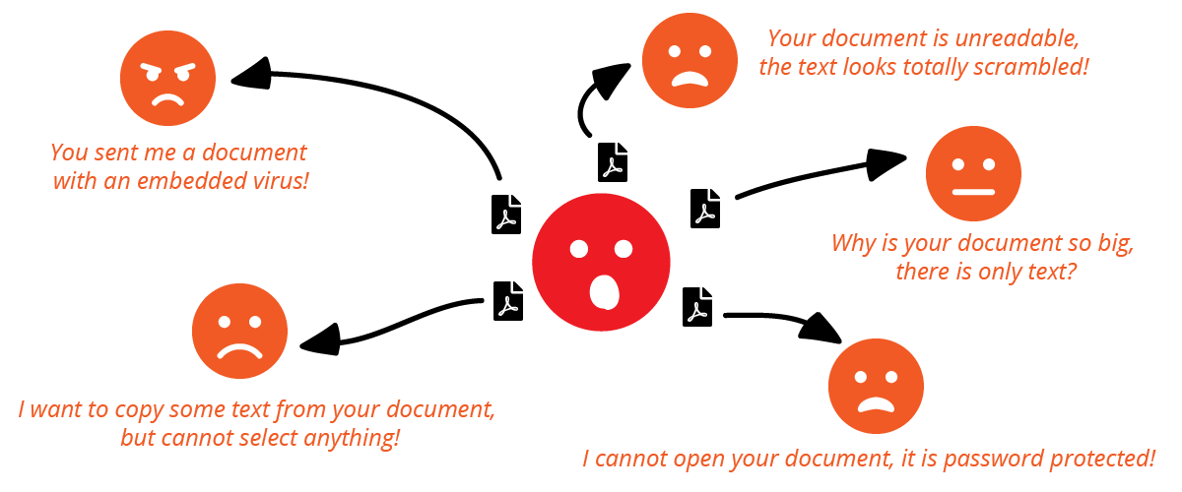
Use Case 1: Conversion
Notes:
Angry customers / doc receivers due to poor document quality
lack of knowledge
«wrong» format
bad configuration
bad conversion tool
non-conform
produces (partially) corrupt documents
No quality control

Slide 3
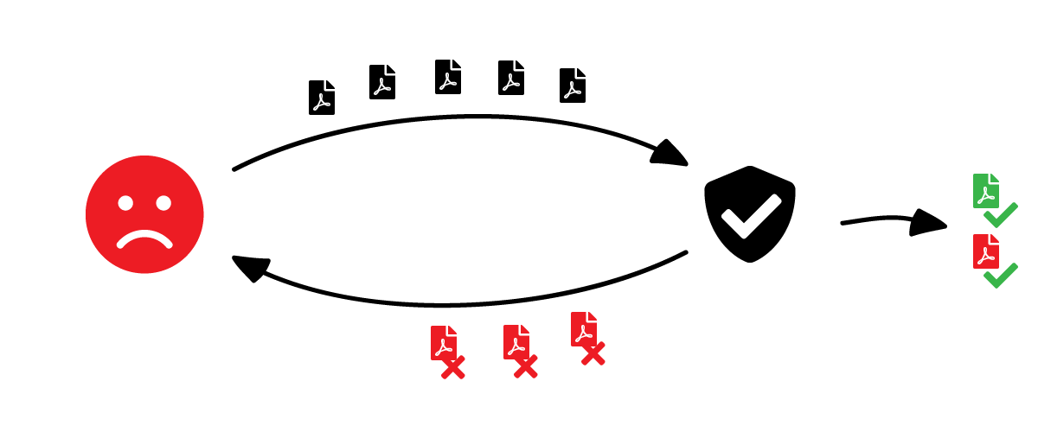
Use Case 2: Quality Control
Notes:
Lots of rejected documents
poor document quality
wrong or too strict configuration
Some documents pass validation even though they shouldn’t
insufficient validation
User acceptance
«Quality is important until it interferes with daily business»
Users are creative → e.g. print, then scan the document, so it passes

Slide 4
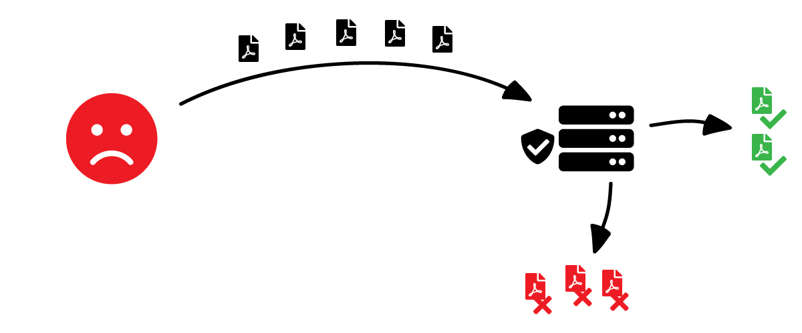
Use Case 3: Automation
Notes:
Lost documents due to
(partially) undefined process
missing error handling (e.g. conversion error, validation error, service unavailable, network error, …)
complicated workflow / process
use of different tools that do not work well together
use of low quality tools
lack of knowledge
lack of user acceptance

Slide 5
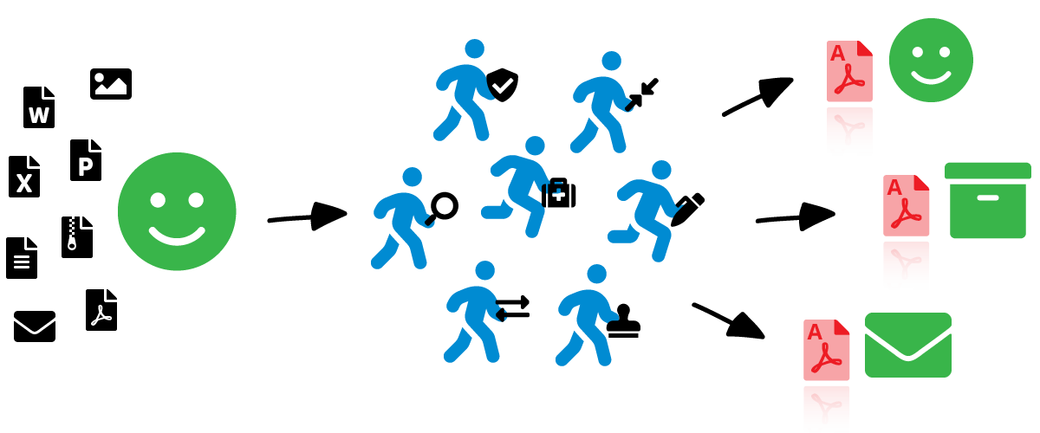
Solution
Notes:
Set up one solution for your process.
Ideally it
can handle all incoming documents (external / internal digital- and analog-born)
can do all the necessary steps required for your individual process
provides high document and processing quality at each step
is configurable for your individual process
is extensible. Do you know what the future holds? Maybe new corporate guidelines will suddenly require you to digitally sign all your documents.

Slide 6
Quality Control – How To
Ensure high-quality input documents
Format, image compression, resolution
PDF is great…
Standardized, viewable on many devices
Structured objects: Text, raster and vector graphics
Saves storage space in archives (TIFF replacement)
…but not enough → use PDF/A

Slide 7
Quality Control – How To
TODO: examples of «bad» PDF documents and why you should use PDF/A
Notes:
Missing / linked information (e.g. fonts, images)
Ambiguity
Corrupt fonts (not printable, not viewable in some viewers)
Password protection
Duplicate content
Malicious content

Slide 8
Benefits of PDF/A
Inherits the benefits of PDF
And preserves visual appearance
No document modification through scripts or other means
All fonts of visual text are embedded
No external or alternate resources (images)
Print is identical to screen
Searchability (with OCR / compliance level U)
Notes:
PDF/A-1 was introduced in 2005 as an ISO standard, that based the Adobe PDF Standard 1.4 (2001). It is limited to PDF features of that time (e.g. no transparency).
PDF/A-2 came out in 2011 and is based on ISO PDF 1.7. It is the current standard for PDF/A.
PDF/A-3 is identical to PDF/A-2 and additionally supports proprietary file attachments (e.g. used by Factur-X)
PDF/A-4 is planned to be published in 2019/20 and based on ISO PDF 2.0 (2017)

Slide 9
PDF/A Conformance Levels
PDF/A
PDF
Level B
Level U
Level A
Highest
Conformance
A U + Contains logical structure and tagging used for accessibility
U B + All text must be Unicode
B Basic PDF/A conformance (e.g. PDF/A-2b)

Slide 10
Limitations and Drawbacks of PDF/A
embedded fonts and color profiles increase the file size
PDF/A allows all PDF signatures, including unsafe types
PDF/A cannot recover poor quality of content
(e.g. image compression, resolution)
encryption is prohibited
Issue
embed only the used characters (sub-setting)
use sRGB profile (4KB)
use PAdES
use a quality check to detect defects
use format independent access controls
Solution

Slide 11
Quality Control – How To
Validate your PDF/A documents completely
PDF/A (ISO-19005)
PDF (ISO-32000)
Referenced specifications (images, metadata, color management, fonts, signatures, …)
Notes:
Validating against PDF/A only is not enough
If only PDF/A is validated, the documents’ content can still be corrupted (e.g. fonts, images etc)

Slide 12
Quality Control – How To
TODO: examples of «bad» documents that are not validated completely

Slide 13
Conversion – How To
Convert PDF to PDF/A
Take conform content
Repair nonconform content
Corrupt parts (fonts, encodings, …)
Inconsistent data (metadata, fonts, …)
Ambiguous content (form fields, …)
Remove prohibited content
Javascript
Transparency (PDF/A-1)
Embedded files (PDF/A-1/2)
Embed fonts
copy
PDF Document
copy & repair
PDF/A Document
copy & repair
copy
remove
Notes:
Loss of information: This is on purpose and improves the quallity (consistency) of the document

Slide 14
Conversion – How To
TODO: examples of failed PDF to PDF/A conversion

Slide 15
Conversion – How To
Convert mail / HTML to PDF/A
Conversion not clear
Define the expected result first!
How should it look?
cover page, paper size, portrait vs. landscape, html formatting
What should happen with attachments?

Slide 16
Conversion – How To
TODO: examples of failed mail/HTML to PDF/A conversion

Slide 17
Conversion – How To
TODO: image to PDF/A, office to PDF/A

Slide 18
Conversion – How To
TODO: use high-quality converter
Notes:
Some errors cannot be caught by quality control
Other potential topics
Searchability
Is there any searchable content?
Is it embedded correctly?
Enhancements (Optimization, OCR, …)

Slide 19
Automation / Process – How To
Carefully analyze and design your process
Error handling is important
Optimize integration
Tools should interact smoothly
Factory vs. single components
Optimize quality
Care for quality at each step
One weak link can break the chain

Slide 20
Automation / Process – How To
Optimize user experience
If it’s a hassle, people will not use your tools
Or they will try to cheat the system
Make it easy to get help
Educate yourself and your users
Know how to use your tools
Use your tools the right way

Slide 21
In a nutshell
Know your problem
Create fitting process / solution
Build your solution
Get your users to love and use your solution
Care for your solution continuously
There is no general solution!
Notes:
Each business process and its corresponding document workflow is different → you need an individualized solution
It’s worth to ask an expert

Slide 22
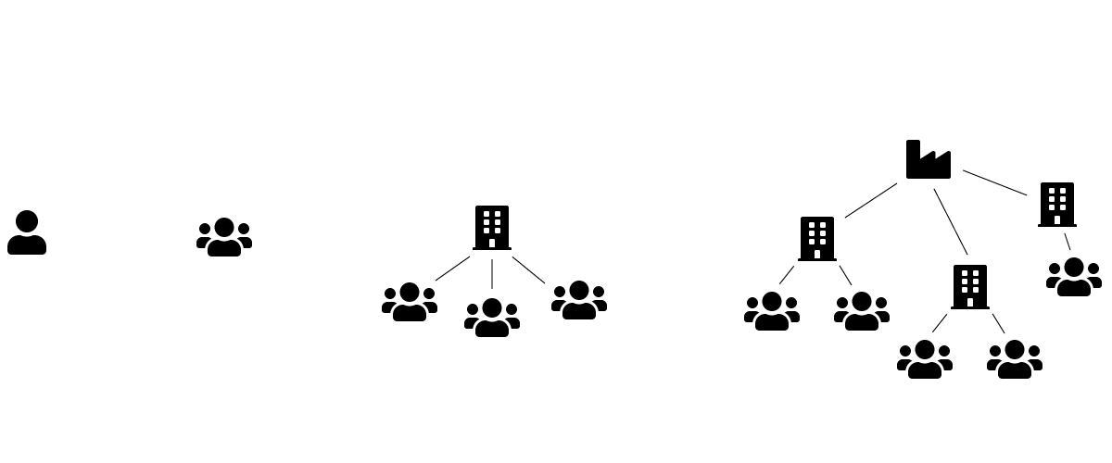
Size doesn’t matter…
Notes:
No matter if you are a one man show, small to medium firm, a company with several departments or even a multicorporate enterprise
you will have to process documents
the challenges will vary, but one thing remains the same: quality matters! All the way!

Slide 23
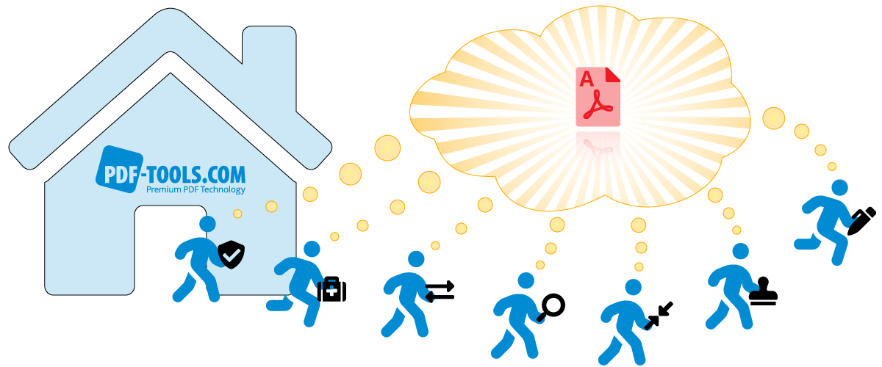
… but quality does. All the way.

