Slide 1
PassportPDF: New Way to Go PDF, on Earth and Beyond!
Solving Complex Document Challenges

Slide 2
Meet our Speakers
Loïc Aigon & Elodie Tellier from ORPALIS

Slide 3
What we will cover
Hyper-compression
Annotation & collaboration
PDF/A conversion & validation
Redaction & privacy
Electronic signature
Security
Integration & pricing

Slide 4
Issues
A new law states that all companies making business with Mars must use electronic invoicing and archiving, starting 01/01/2020.
The first GDPR fines have been issued.
Mars Cycles is already late to comply to the law, so the company needs a solution, fast.
Mars Cycles is using many different tools for various services, making processes long and often complex.

Slide 5
PassportPDF
Cloud ecosytem to simplify PDF and electronic documents management for everyone: individuals, professionals, and developers.
PassportPDF provides microservices to manage the full electronic document lifecycle, from acquisition to storage.
Users can consume the microservices the way they want: desktop apps, online services, APIs, SDK.

Slide 6
Hyper-compression
PROBLEM
Mars Cycle documents volumetry is very large.
SOLUTION
Hyper-Compression significantly decreases files size.
RESULT
Company’s global storage is dramatically reduced.

Slide 7
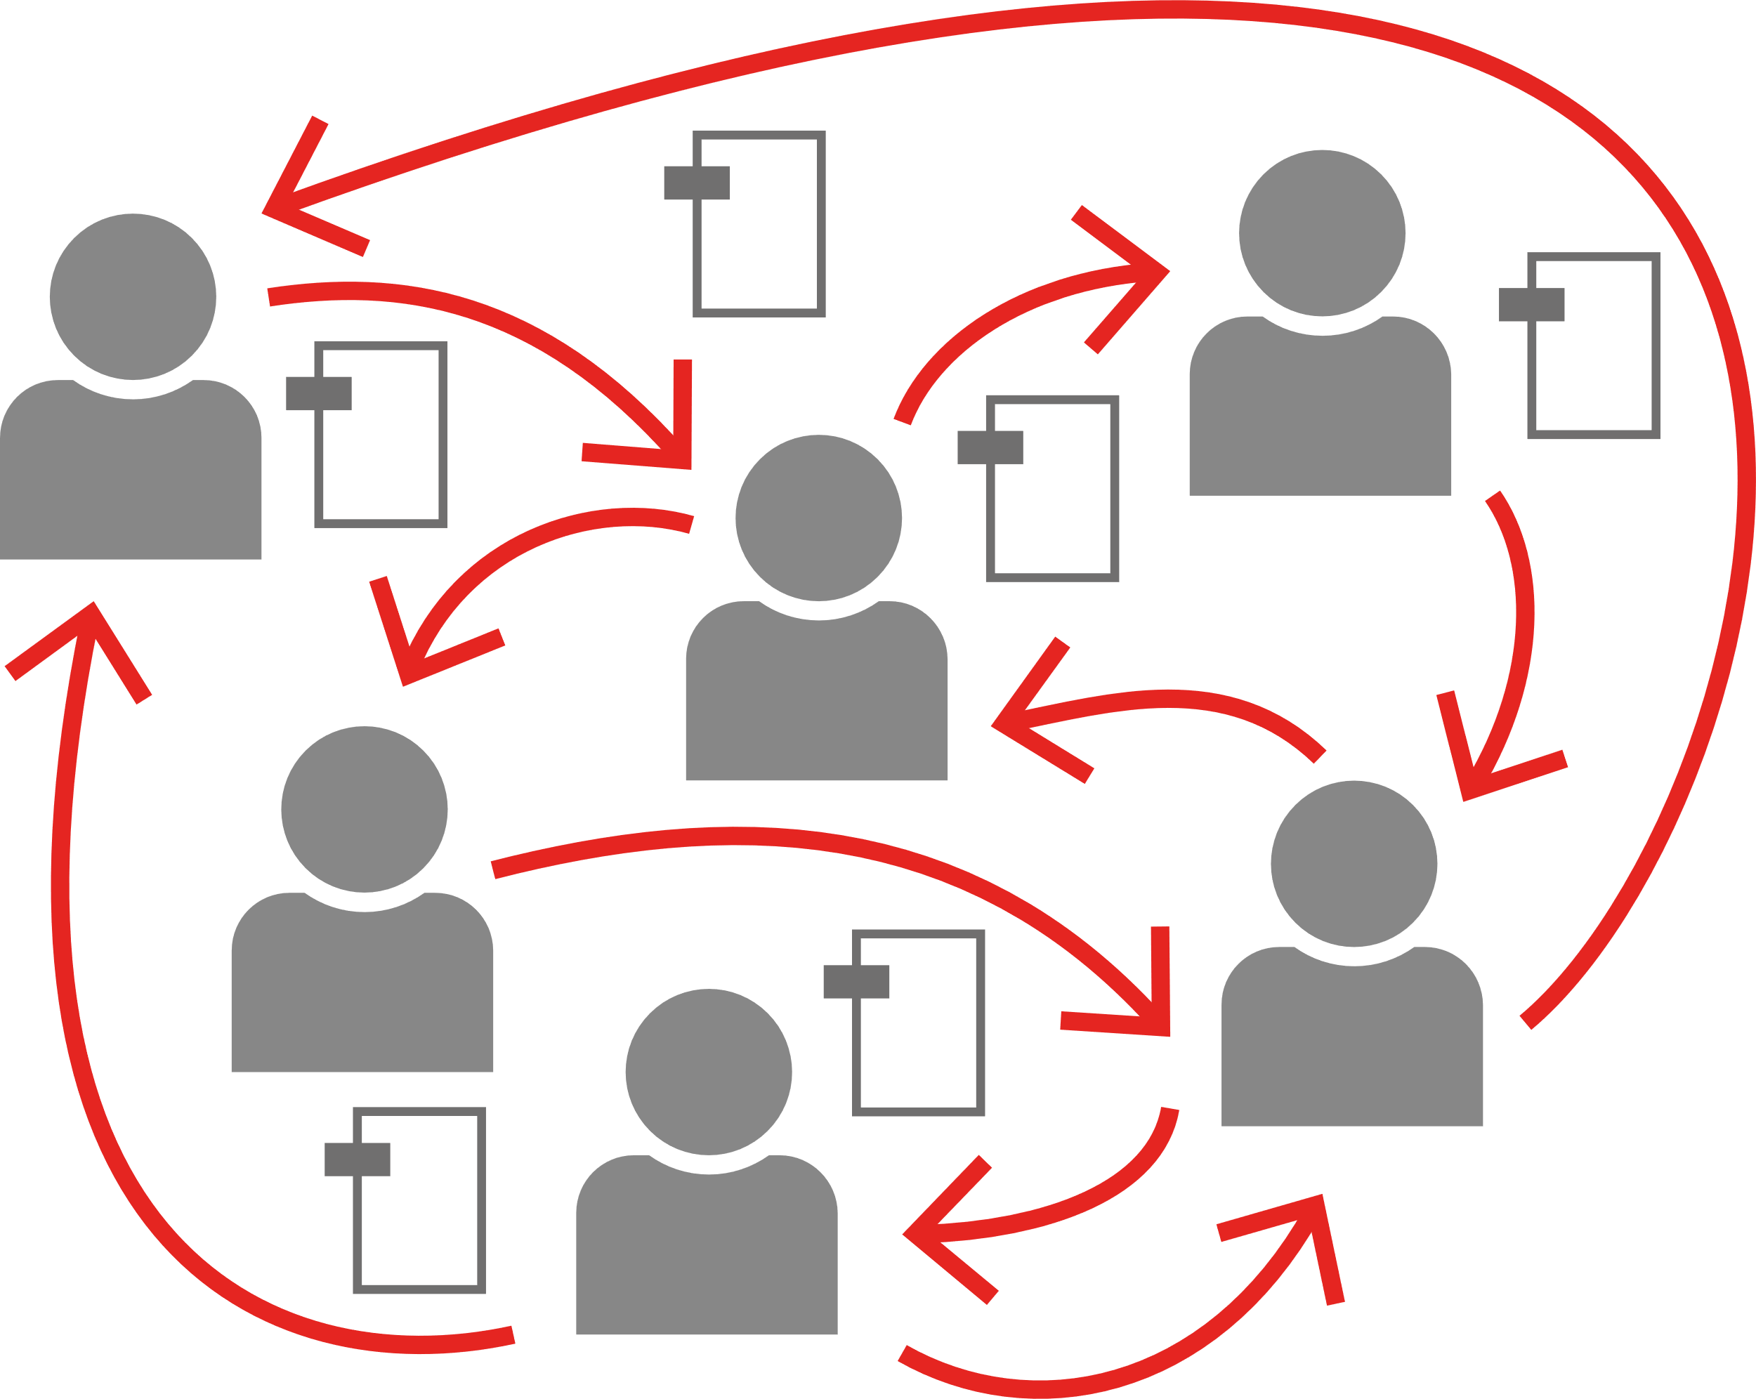
Annotation & collaboration
?
PROBLEM
Mars Cycle suffers projects delays from poor internal collaboration workflows.
SOLUTION
The Annotation and Collaboration allows teams to share their thoughts on a single document
RESULT
Managers speed up the Time-To-Market of the Company

Slide 8
PDF/A conversion & validation
PROBLEM
Some Bicycles’ users manuels and blueprints cannot be read anymore.
SOLUTION
PDF/A Conversion guarranties long-term conservation.
RESULT
Mars Cycles’ legacy is preserved! Files will still be readable in the long-terme future as warranted by VeraPDF PDF/A check.

Slide 9
Redaction & privacy
PROBLEM
Some documents contain sensitive that needs to be hidden.
SOLUTION
With the redaction featur, users can black document out. Hidden data are definitively deleted.
RESULT
Mars Cycles is now confident sharing its electronic documents.

Slide 10
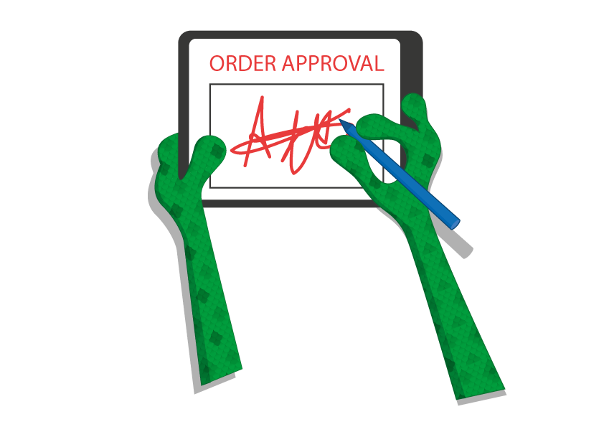
Electronic signature
PROBLEM
Mars Cycles wants to secure its orders with a strong commitment from customers.
SOLUTION
PassportPDF digital Signature allows customers to validate orders online.
RESULT
Customers contestation has been reduced and orders are now processed quicker.

Slide 11
Security
PROBLEM
The company wants to avoid competition to access confidential documents.
SOLUTION
PassportPDF locks PDFs with Password Protection.
RESULT
Sensitive documents are now safe. Curious how competition lost big market share recently…

Slide 12
A flexible solution for users
Desktop apps: suitable for integration into the existing Windows solution developed for the company many years ago.
APIs to chain microservices: suitable for the new contracted team of Millenials developers hired by Mars Cycles to finish their digitization process.
Online tools & widgets: suitable for Mars Cycles’ website to ease the order process and encourage best practices in the company.

Slide 13
A flexible pricing
SaaS solution with a flexible per usage model
Free online tools

Slide 14
Conclusion
Mars Cycles wins first GreenIT award for the red planet.
The company replaces many tools with PassportPDF, like BaaY for OCR, tools for to manage forms fields, accessibility with PDF/UA for documentation & invoices.

Slide 15
Thank you for your attention!
Any questions?
ORPALIS & PassportPDF info

